Slide 1
Calming the Chaos: Parenting in Times of Change
Dr. Julene Nolan, Psy.D., LP, NCSP
President and Owner, Phoenix School Counseling
www.phoenixschoolcounseling.com
drjulesnolan@gmail.com

Slide 2
co-parenting, loss, relocation, family conflicts, financial strain, schedule disruptions, and vacation/holiday misbehavior
focus on actionable strategies grounded in behavioral science and parenting psychology
Guiding Principles:
Modeling emotional regulation: your reactions guide your child
Building connection and predictability: creating safety during uncertainty.

Slide 3
Co-Parenting Through Stress
Scenario: A 2nd grader becomes tearful when transitioning between homes during school breaks.
Strategy:
Coordinate consistent routines across households.
Use a transitional object (e.g., a favorite toy or note).
Practice calm, neutral exchanges with the co-parent.
Behavioral Science Tip: The impact of predictability on reducing separation anxiety.

Slide 4
Navigating Loss and Grief
Scenario: A 5th grader withdraws and refuses to participate in family traditions after a grandparent passes away.
Strategy:
Allow space for grief while maintaining some traditions.
Use age-appropriate explanations of loss and encourage storytelling about the loved one.
Suggest creating a "remembrance ritual" as part of the family holidays.
Psychological Insight: Validate feelings and avoid forcing participation in joyful activities prematurely.

Slide 5
Relocation and New Beginnings
Scenario: A 3rd grader struggles to make friends after a family move and acts out during family events.
Strategy:
Role-play social scenarios to boost confidence.
Join community or school events for social exposure.
Praise small efforts, like saying hello to a new peer.
Parenting Psychology Insight: Encourage belonging by emphasizing family identity: “No matter where we live, we are a team.”

Slide 6
Handling Family Conflicts
Scenario: A 6th grader overhears an argument between parents about spending and expresses anger by yelling at siblings.
Strategy:
Use "repair" conversations to model resolving conflict calmly.
Have private, age-appropriate discussions with the child about family stress.
Teach and practice calming techniques, such as deep breathing or grounding exercises.
Behavioral Science Tip: Normalize disagreements as part of relationships and model healthy resolutions.

Slide 7
Managing Financial Strain
Scenario: A 4th grader expresses disappointment over not receiving a coveted birthday gift due to budget constraints.
Strategy:
Emphasize experiences over material gifts (e.g., family game night).
Be transparent about limits while expressing optimism: "We’re focusing on what matters most—time together."
Encourage gratitude by having children identify what they’re thankful for daily.
Parenting Psychology Insight: Gratitude practices help shift focus from scarcity to abundance.

Slide 8
Misbehavior During Holiday Gatherings
Scenario: A 1st grader refuses to sit at the table or follow rules during family meals.
Strategy:
Prepare the child in advance with clear expectations and role-play.
Offer incentives like a small reward for cooperation.
Use a quiet space for breaks if the behavior escalates.
Behavioral Science Tip: Reinforce good behavior immediately and specifically, focusing on what went well.

Slide 9
Anxiety
Preparing for Holiday Schedule Disruptions (Kindergarten)
Scenario: A kindergartener becomes clingy and cries when routines change, such as staying up late or visiting new places.
Strategy:
Use visual schedules or picture charts to preview the day’s activities.
Build in familiar routines (e.g., bedtime stories) even in new environments.
Practice transitions by role-playing or reading books about holiday activities.
Behavioral Science Tip: Predictability reduces anxiety in younger children.

Slide 10
Coping with Social Challenges at Gatherings (7th Grade)
Scenario: A 7th grader isolates themselves at a family gathering, claiming it's "boring" and scrolling on their phone.
Strategy:
Set expectations for limited screen time beforehand.
Assign the child a role to encourage engagement (e.g., helping set up games for younger cousins).
Acknowledge their discomfort but frame participation as a skill-building opportunity.
Parenting Psychology Insight: Adolescents value autonomy, so involve them in decision-making for plans.

Slide 11
Sibling Rivalry Intensified by Stress (4th Grade)
Scenario: A 4th grader starts fights with a younger sibling, claiming they get more attention and preferential treatment.
Strategy:
Carve out one-on-one time for each child, even if brief.
Set clear family rules about respectful communication and consequences for aggression.
Praise teamwork when siblings cooperate during tasks or play.
Behavioral Science Tip: Reinforcing positive sibling dynamics reduces rivalry over time.

Slide 12
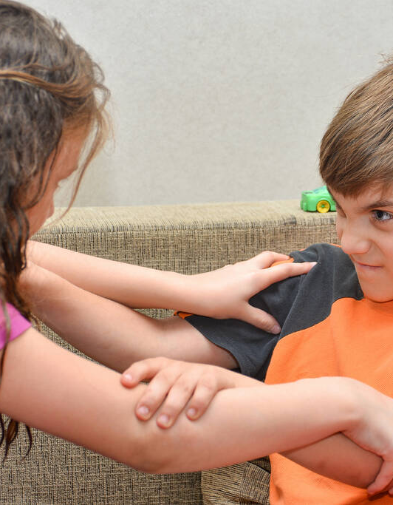
Balancing Academic Responsibilities and Holiday Fun (8th Grade)
Scenario: An 8th grader procrastinates on a long-term project due after spring break, leading to stress and late-night work.
Strategy:
Help the child break the project into manageable steps with deadlines.
Encourage a “work first, play later” approach with short study sessions followed by holiday activities.
Model planning by sharing how you balance tasks and holiday commitments.
Parenting Psychology Insight: Teaching time management skills fosters independence and reduces last-minute panic.

Slide 13
Adjusting to a New Family Dynamic After Divorce (2nd Grade)
Scenario: A 2nd grader refuses to talk about their time at the other parent’s house and acts out when asked about it.
Strategy:
Avoid pressing the child for details; let them share at their own pace.
Offer neutral statements like, “It’s okay to miss the other parent while you’re here.”
Keep transitions calm and predictable, and avoid speaking negatively about the other parent.
Behavioral Science Tip: Acknowledge the child’s loyalty binds and provide a safe space for emotional expression.

Slide 14
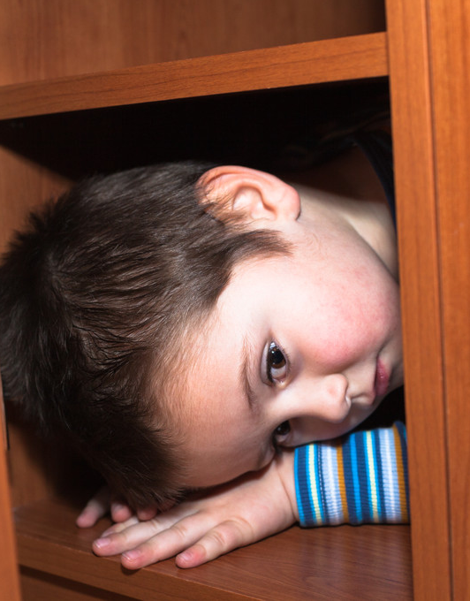
Handling Gift Envy (3rd Grade)
Scenario: A 3rd grader complains, “It’s not fair! My cousin got way cooler presents than I did.”
Strategy:
Acknowledge their feelings without shaming: “I hear you. It can be hard when someone else gets something you really like.”
Shift focus to gratitude: Encourage them to name their favorite gift or a holiday moment they enjoyed.
Create a meaningful tradition: Suggest making a list of things they’d like to save up for or work toward in the future.
Behavioral Science Tip: Teaching gratitude and delayed gratification fosters resilience and reduces comparison-based dissatisfaction.

Slide 15
Coping with Family Expectations (5th Grade)
Scenario: A 5th grader complains they’re “too old” for a family traditions
Strategy:
Validate their growing independence: “I get it—things that used to be fun can feel different now.”
Find a compromise: Let them opt for a more age-appropriate role, like helping younger siblings or picking the family activity.
Celebrate their individuality: Praise their input and willingness to contribute in their own way.
Parenting Psychology Insight: Balancing a child’s desire for autonomy with family traditions helps them feel respected while staying connected. MATTERING

Slide 16
Scenario: A kindergartener throws tantrums at large gatherings, overwhelmed by noise and unfamiliar faces.
Strategy:
Provide a warm-up: Arrive early to help them adjust gradually as others arrive.
Create a sensory-safe space: Designate a quiet corner with headphones, books, or fidget toys to help them decompress.
Use social stories: Before the event, explain what to expect and how to handle feelings, like asking for a break.
Behavioral Science Tip: Helping young children recognize and manage sensory overwhelm builds self-regulation skills over time.

Slide 17
Take Aways:
Parents are the steady calming influence for children’s emotions and behavior. Nothing is too big or scary for YOU.
Our job is to help them learn the skills to tolerate discomfort – NOT to make sure things run smoothly
Children need to MATTER in their family. That means meaningfully serving the whole, NOT being the center of the family’s efforts
Teaching gratitude (not shame) by practicing gratitude, not lecturing
Increase 1:1 time spent, especially in 8th and 9th grade.
Anxiety is best managed when recognized, acknowledged, and challenged.
Stress is the “heavy lifting” of cognitive resilience. Can’t avoid it. Learn to alleviate it in healthy ways

